Slide 1
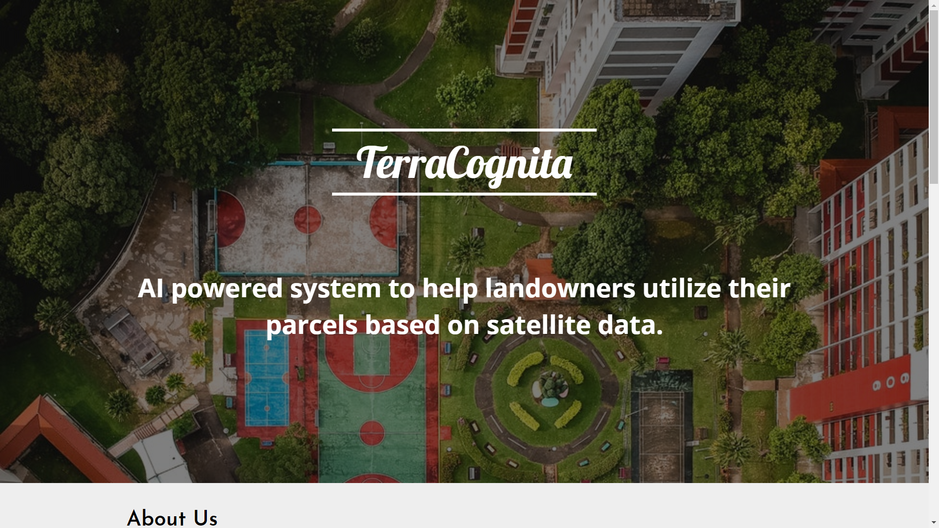

Slide 2

problem
Notes:
Pain in the ass: Cities – info up-to-date about land, urban planning, green areas maintanance; Citizens – quality of air, free time, estethics; Farmers – info about land and crops, automated planning. Green is good...

Slide 3

target customer
landowners and administrators
4+ hectares of land spend 50€/ha/y
Notes:
Sell to subcontractors: greenery caretakers

Slide 4
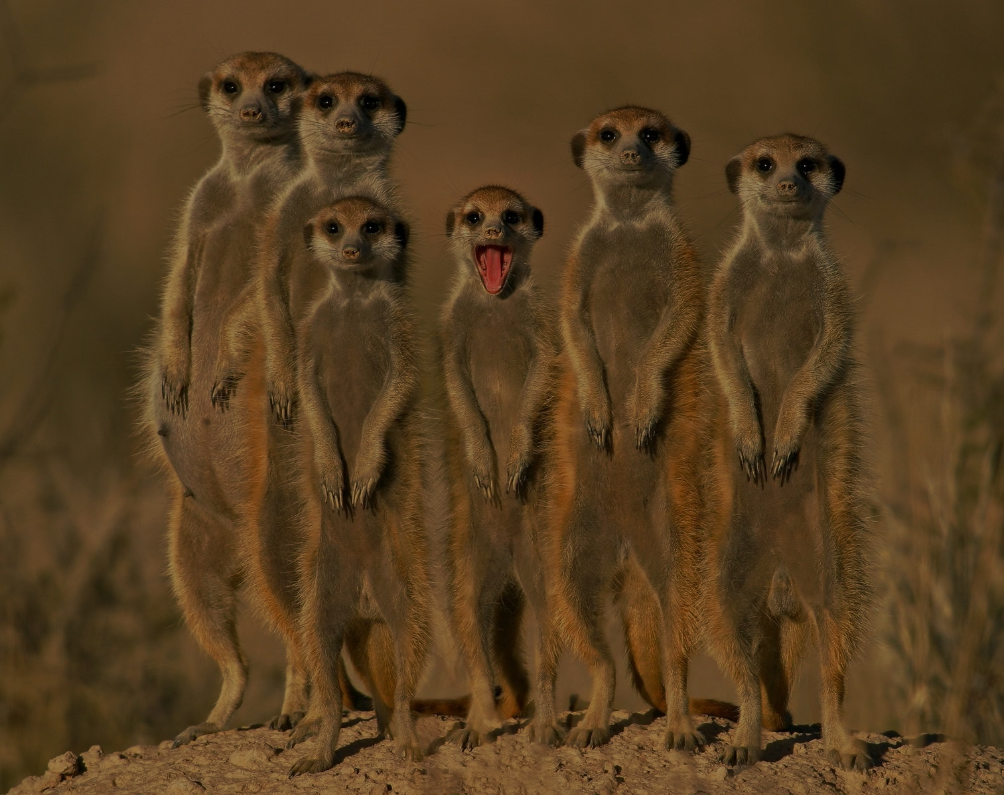
team
Andrej Petrinec
Martin Hrabovec
CTO
CEO
Notes:
Andrej: geodetics, urban planning, B2G – 14 years. Martin: manages software developers, and takes care for customers – 5 years expirience +mentors thank you

Slide 5
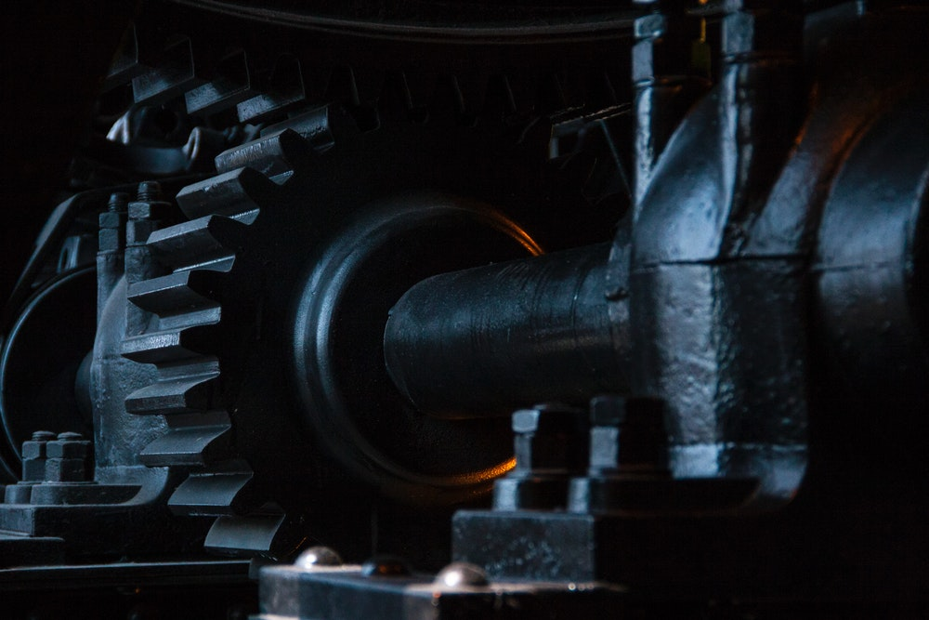
solution demo
Notes:
How copernicus was used? Sentinel-2 data, openstreet data.
Customers get an output up-to-date todo list, posssibility to optimize service routes and sessions.

Slide 6

market size
1 201 690 000 000
$
smart-cities industry
+
2 400 000 000 000
$
agricultural industry
Notes:
World agricultural production is expected to grow nearly 1.5% yearly. Growing. That is tesla roadster for everyone in Kazachstan. Or we could finally rebuild Bratislava train station.

Slide 7
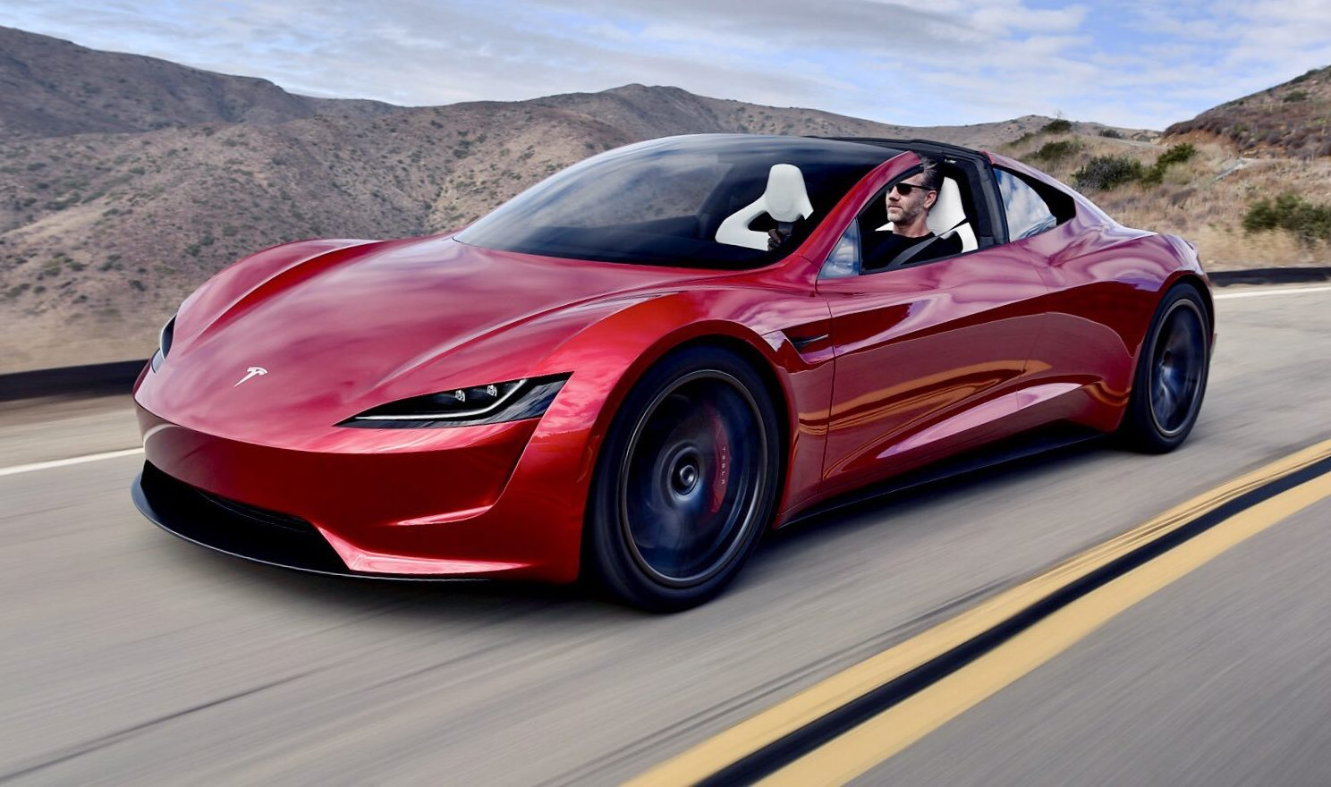


Slide 8
market size
1 201 690 000 000
$
smart-cities industry
+
2 400 000 000 000
$
agricultural industry
Notes:
World agricultural production is expected to grow nearly 1.5% yearly. Growing. That is tesla roadster for everyone in Kazachstan. Or we could finally rebuild Bratislava train station.

Slide 9
business model
we save 2,5€/ha/year
Urban: subscribtion based 1€/ha/year
Private: subscribtion based
Notes:
We save public money, and private money for farmers (public money partly) Bratislava: 12 000 ha.

Slide 10

competition
SCALABLE
US agro: descartes lab US urban: EarthNow
EU:
laser imaging companies
traditional scanning methods
Notes:
US: agro company, EU urban: laser images companies; Not-scalable expansive, slow solutions. We are cheap.

Slide 11
timeline
MVP proof of concept
pilot with Bratislava city farmers intro
Slovakia other data sources
EEMEA
10.2018
11.2018
2019
2020
Notes:
Use the funds to launch a pilot with Bratislava

Slide 12

sign-up today
terracognita.tk
Notes:
If you are a landowner Or sign up your city

